Slide 1
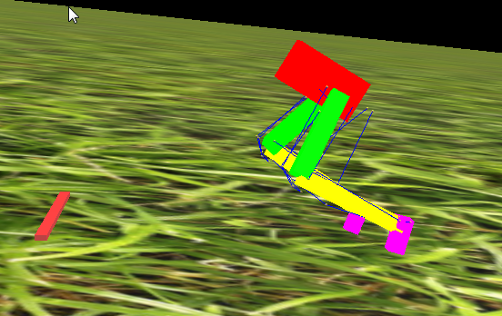
Project Update 1/27/2020
What we aim for:
2D, sagittal model with more muscle
Including the biarticular muscle. ☑
Remove the rear support (tail) and reduce the mass on the front. ☑
Finalize the biarticular control and the kinematic motions.

Slide 2
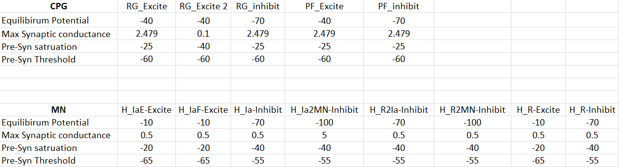
Normalize the neuronal parameters:
Split all synapse in 3 categories:
Common neuron connection
Subnet Feedback connection
Global feedback connection
The goal is:
Reduce the computational cost
Tune as fewer parameter as possible
First target the max conductance then the type.
Common neuron connection:

Slide 3
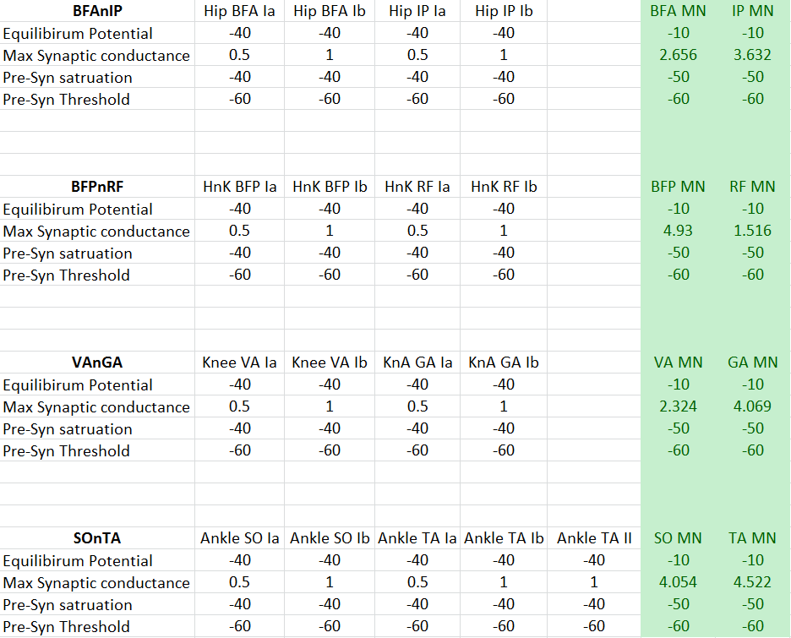
Subnet Feedback connection
The main tuning focus for this part is the PF-MN excitation.
The weight of Ia feedback is half of Ib feedback.

Slide 4
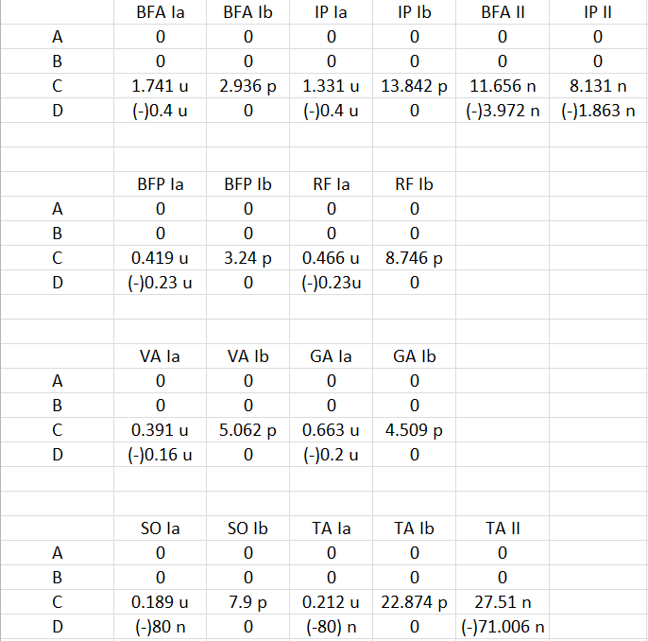
Neuron to muscle adaptor:
Polynomial curve:
Y = A*X^3+B*X^2+C*X+D
Base on reference and Alex previous work, all neuron to muscle adaptor is linear adaptor, but the feedback might be nonlinear.
Notes:
Ia Length and velocity IB muscle tension II length of the PE

Slide 5
What we focus next:
Tuning the global feedback
Explore muscle and receptor(1/100 of muscle) parameter
Exploring two confusion from Alex previous work
The existence of PF inhibit IB connection
Is the fictive feedback same when we adding more muscles?
Notes:
Hip FLX Ia, EXT and FLX II, Ankle EXT IB…..

Slide 6
